Slide 1
SA Genie
Capstone Presentation
Fadilah Daud
Megan Teo
Minju Park
Associate Solutions Architect
Associate Solutions Architect
Associate Solutions Architect
Seoyoung Park
Yong Xuan Chua
Associate Solutions Architect
Associate Solutions Architect

Slide 2
Agenda
Team Introduction
Problem Statement
Solution and Value Proposition
Live Demonstration
Technical Architecture
Solution Pricing Estimates
Future Roadmap

Slide 3
Team Introduction

Slide 4
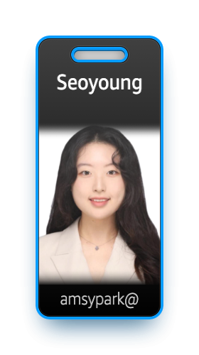
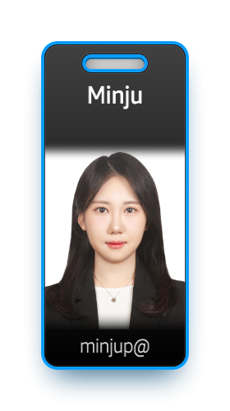
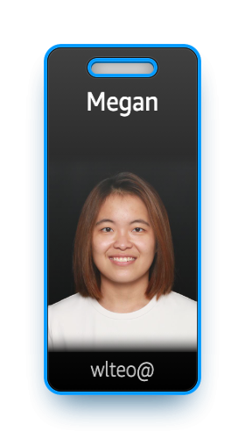
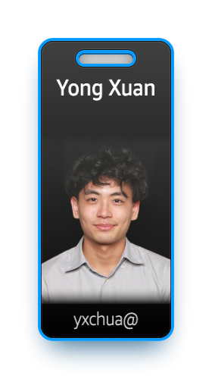
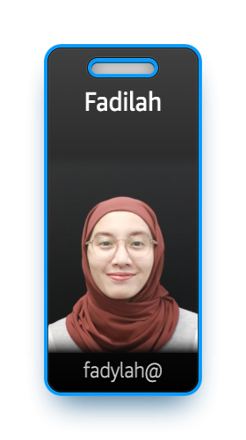
Team Introduction

Slide 5
The Problem

Slide 6



New and experienced SAs often face…
Pressure to answer questions and look for solutions live
Trust gaps when questions can’t be answered immediately
Increased follow-up meetings to address unresolved queries
Difficult to simultaneously manage the conversation flow, recall technical details, and access relevant documentation
Companies lose $62M annually due to poor customer service, with 35% from ineffective communication in sales and support
These delays extend timelines and divert resources, undermining efficiency and project outcomes for all parties.

Slide 7
SA Genie

Slide 8

Key Features of SA Genie
Cross-platform Compatibility
Re-usable across meeting platforms such as Amazon Chime and Microsoft Teams
Invisible Overlay
Answers are powered by GenAI, and displayed near real-time
Data Protection and Privacy
Secure identity and access management

Slide 9
Overall, SA Genie aims to…
Reduce the need for follow up meetings or emails
Provide faster technical support without disrupting screen share
Improve SA’s confidence in responses and customer trust

Slide 10
Live Demonstration
Notes:
Roleplay a customer call

Slide 11
Technical Architecture

Slide 12
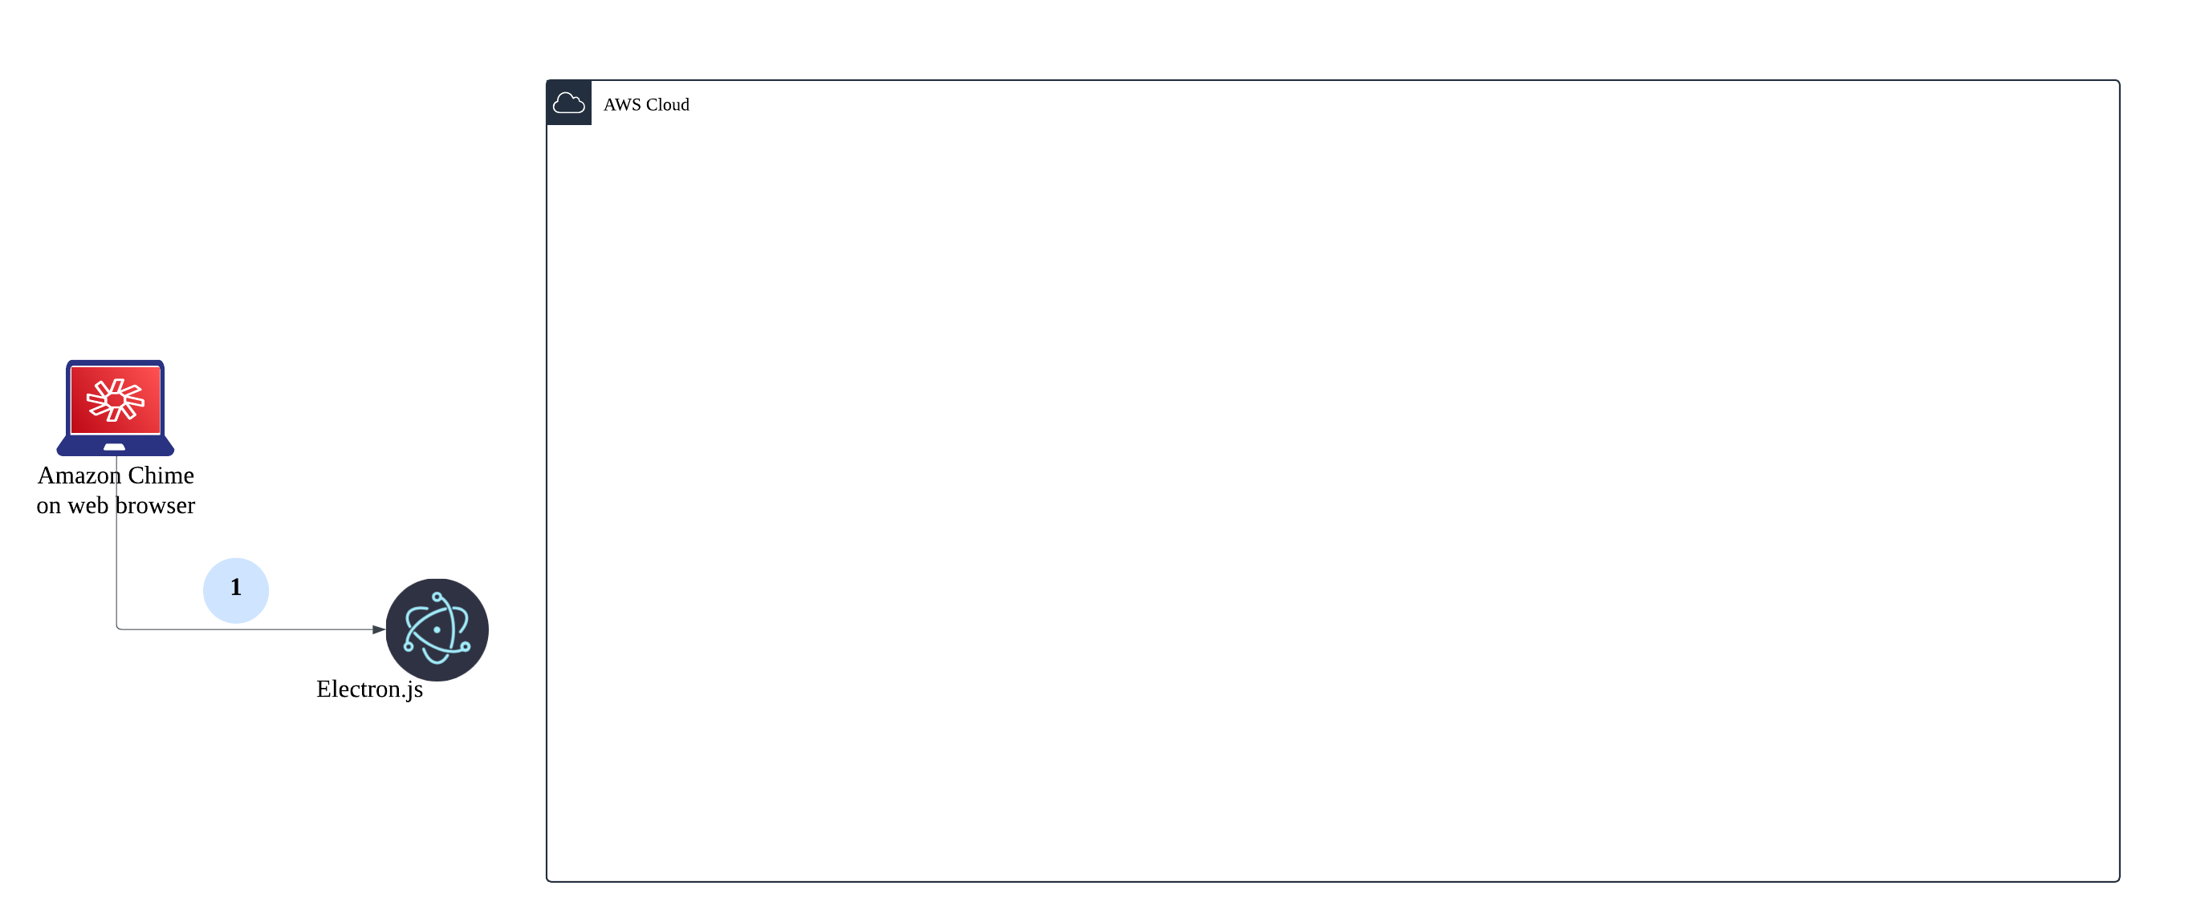
Launch the invisible overlay.

Slide 13
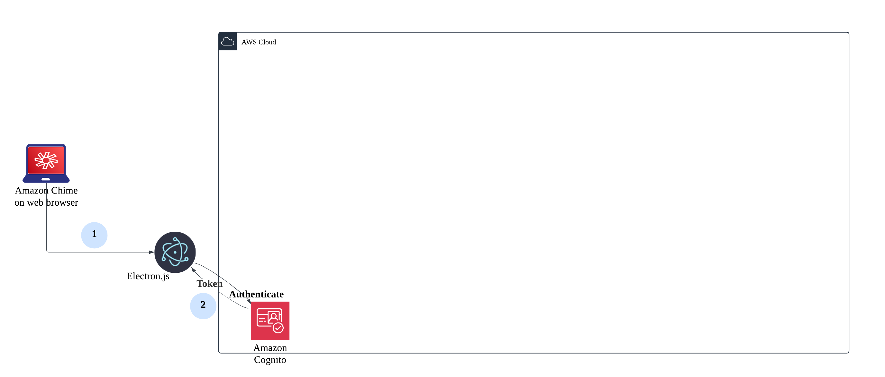
Launch the invisible overlay.
Authenticate with credentials in login window.

Slide 14
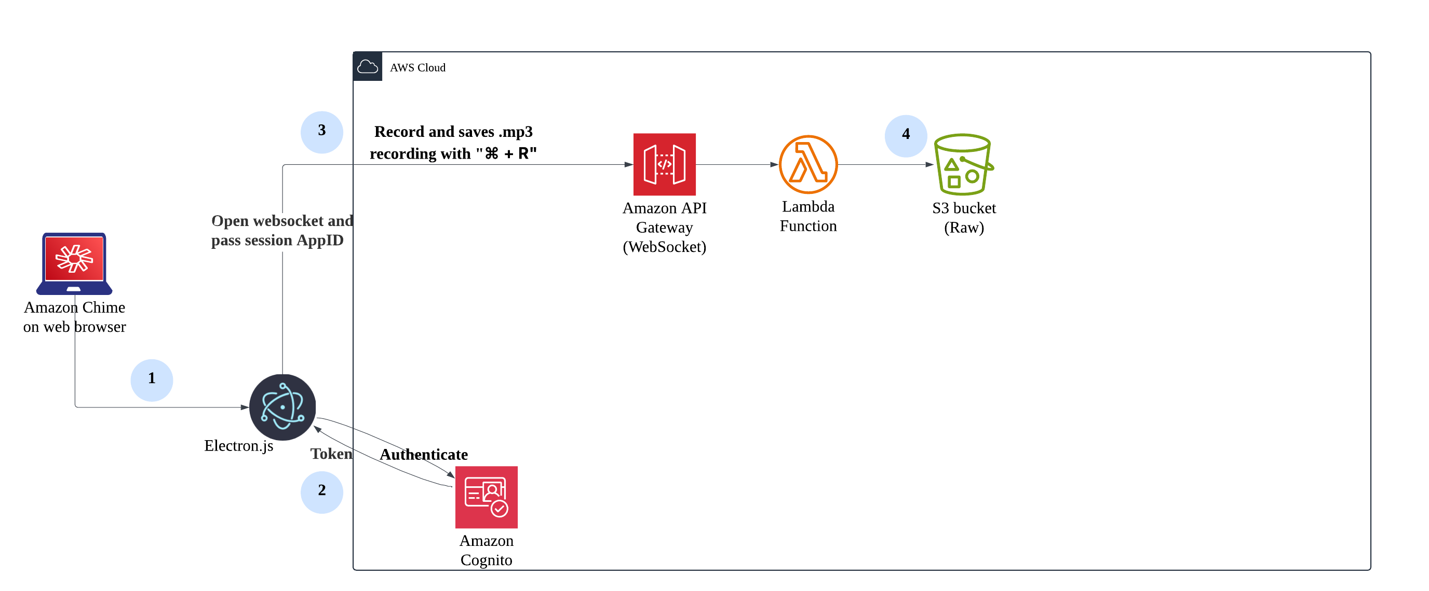
Launch the invisible overlay.
Authenticate with credentials in login window.
Press "Ctrl + R" or "Command + R" to record, save and transfer .mp3 file.
Lambda function is set to pass the audio file from the script and sent to S3 bucket (Raw).

Slide 15
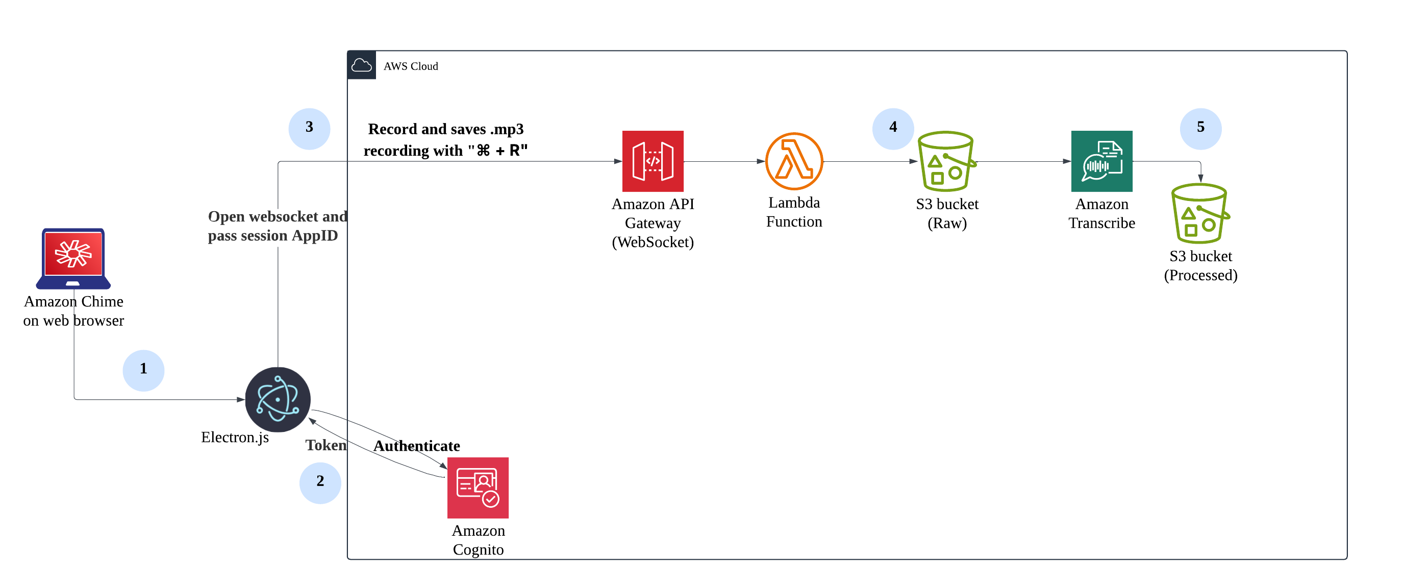
Launch the invisible overlay.
Authenticate with credentials in login window.
Press "Ctrl + R" or "Command + R" to record, save and transfer .mp3 file.
Lambda function is set to pass the audio file from the script and sent to S3 bucket (Raw).
The audio is sent to be transcribed with Amazon Transcribe.

Slide 16
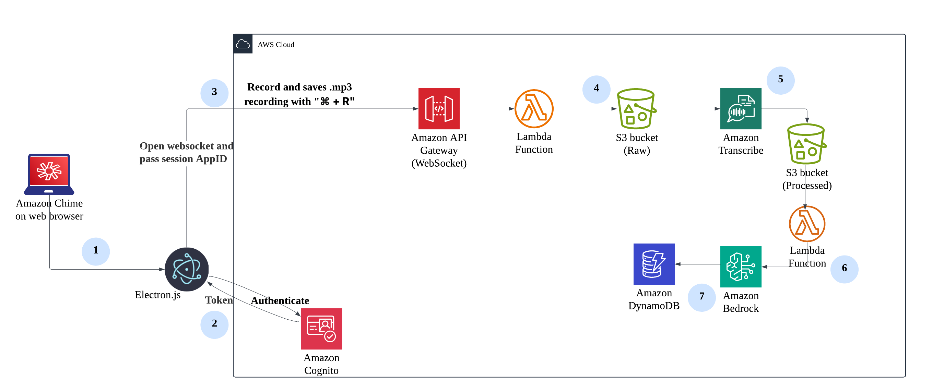
Launch the invisible overlay.
Authenticate with credentials in login window.
Press "Ctrl + R" or "Command + R" to record, save and transfer .mp3 file.
Lambda function is set to pass the audio file from the script and sent to S3 bucket (Raw).
The audio is sent to be transcribed with Amazon Transcribe.
The transcribed file will be passed to the processed bucket and sent for processing with Bedrock.
Bedrock generates a response with Claude Haiku 3.5 and stores the response in DynamoDB.

Slide 17
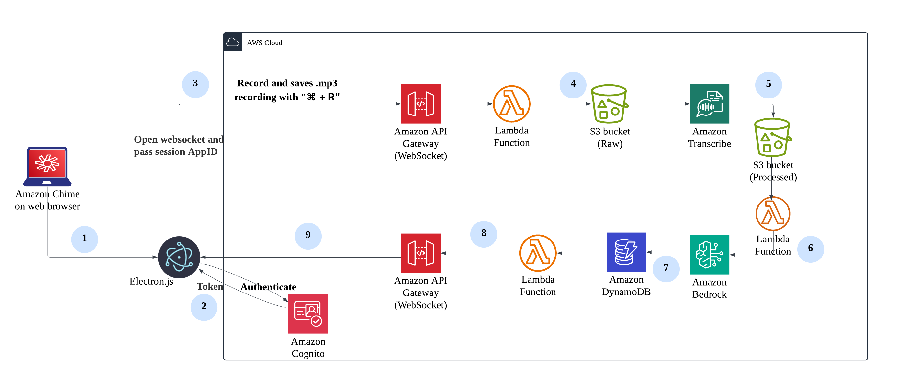
Launch the invisible overlay.
Authenticate with credentials in login window.
Press "Ctrl + R" or "Command + R" to record, save and transfer .mp3 file.
Lambda function is set to pass the audio file from the script and sent to S3 bucket (Raw).
The audio is sent to be transcribed with Amazon Transcribe.
The transcribed file will be passed to the processed bucket and sent for processing with Bedrock.
Bedrock generates a response with Claude Haiku 3.5 and stores the response in DynamoDB.
Lambda function is set to push the response according to the AppID through the opened WebSocket.
The response will appear on the Electron overlay.

Slide 18
Solution Pricing Estimates

Slide 19
Solution Pricing Estimates
Usage Assumption​s
Item | Value
Usage frequency | 10 min/day * 22 days = 220mins/month
Audio file size | Average 5MB
Questions per 10min | Approximately 5 questions
Bedrock response length | ~ 2000 characters /question
Token estimation (Claude 3.5 Haiku) | 1000 characters ≈ 750 tokens

Slide 20
Solution Pricing Estimates
AWS Service | Usage Assumption | Monthly Cost (USD) | Notes
Lambda | 3 functions, short runtime | $0.00 | Under 1M free requests
S3 | ~0.55 GB storage/month | $0.01 ~ $0.02 | Storage cost grows monthly if no deletion
DynamoDB | 5M reads/writes (on-demand) | $6.56 | R/W cost fixed; storage cost negligible
API Gateway | HTTP + WebSocket | $0.04 | Free tier covers 1M requests
Transcribe | 220 mins of audio/month | $6.60 | English audio transcription
Bedrock (Claude 3.5 Haiku) | 110 Q&A/month (8.25K in 165K out tokens) | $0.67 | Input: $0.0008/1K tokens, Output: $0.004/1K tokens
Total Monthly Cost: $13.885, Annual Cost: $166.62

Slide 21
Future Roadmap

Slide 22
Future Roadmap
Refine
Test
Scale
Implementation of RAG models
Responses displayed in more formats, languages
User testing and feedback
Enterprise security features
Adoption as an internal enablement tool
1
2
3

Slide 23
Thank you!

